Slide 1
Networks and database:
Ms. Dhanashree M. Kini
Department of Commerce and Management.

Slide 2
What is computer network????
Interconnected collection of autonomous computers.
Two computer are inter connected if they are capable of exchanging information.
Thus the computer network provides communication path between different computer to share their data and resources with other computers.

Slide 3
classification of computer network:
LAN: LOCAL AREA NETWORK
WAN: WIDE AREA NETWORK
MAN: METROPOLITAN AREA NETWORK.

Slide 4
LAN:
A local area network is a computer network that interconnects computer within a limited area such as a residence, school, laboratory, university campus or office building.

Slide 5
WAN
Interconnection of terminals spread across countries or continents.

Slide 6
MAN
It is intermediate network between a LAN and a WAN is sometimes used to connect computers.

Slide 7
Network topologies:
It refers to the physical layout of the network. This includes all the hardware that make up the network and the points of connection to the network by the station are called nodes or link
It is a systematic connection of network.
A layout of network.

Slide 8
Bus topology
All the computer are connected with main cable.
Data flow in single direction.
Cost effective.
Commonly used in small networks.
Easy to expand.
Slower, and depend on main cable. If, main cable fails all other network will fail.

Slide 9
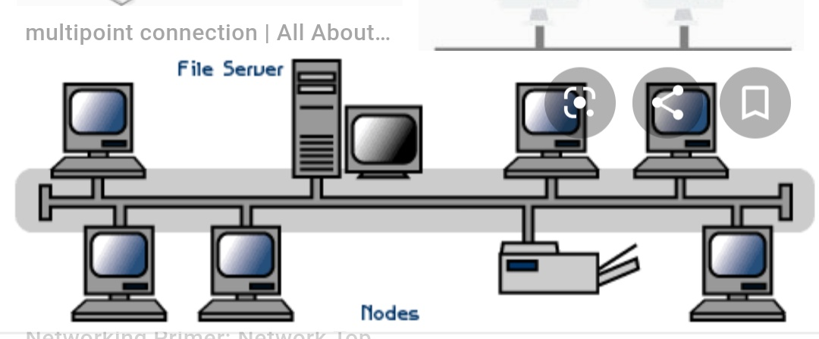

Slide 10
Ring topologies.
Each forms a ring because one computer connected to another. At the last computer connected to first computer.
In this topologies data flow in uni-directional and sometime dual direction.
Effected by high network traffic.
Cheap to install.
If one computer in a ring fails all the network will fail.

Slide 11
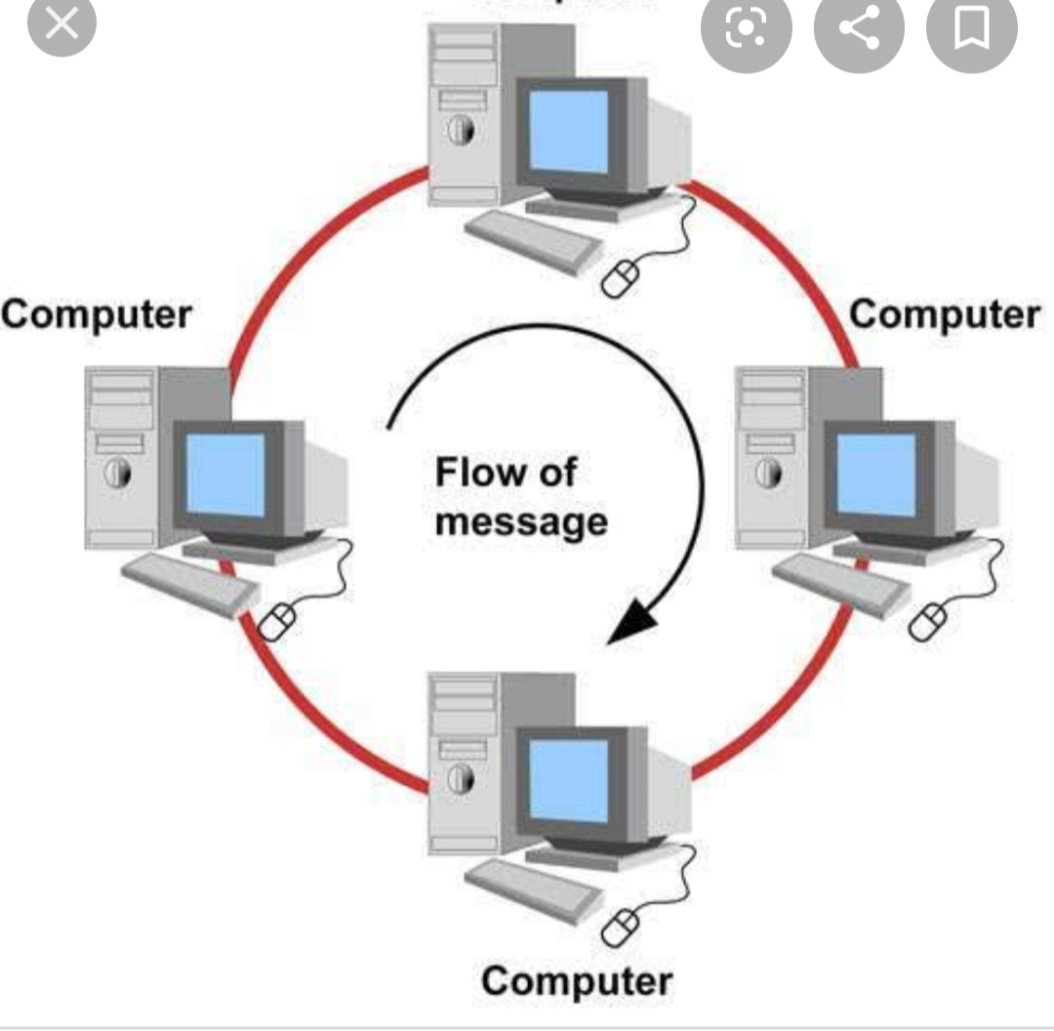

Slide 12
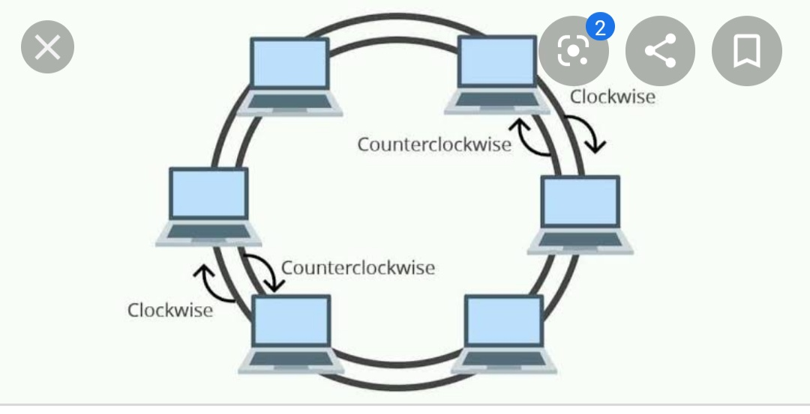

Slide 13
Star topology
All the computer that are connected with that central hub.
Direct connection
Fast performances.
Installation cost high.
If central connection or hub fails automatically all the computer will stop working.

Slide 14
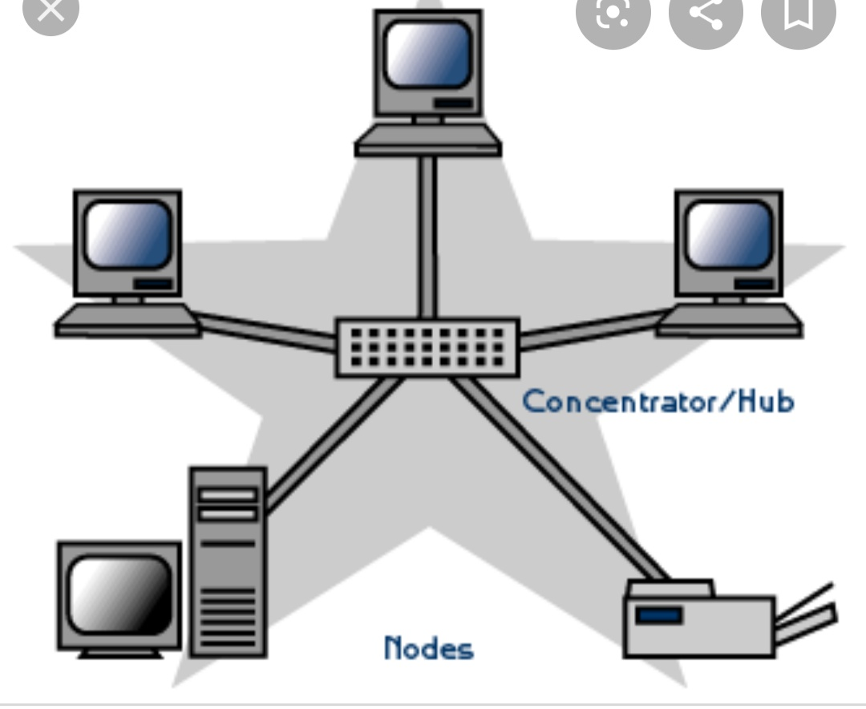

Slide 15
Mesh topology.
It is a point to point connection to the computer. All the network nodes are connected to each other.
Each device interface for every other device on the network.
2 techniques.
Routing: Routing logic used to reach the destination by using the shortest distance.
Flooding: same data is transmitted to all network node. It leads unwanted load over network.

Slide 16
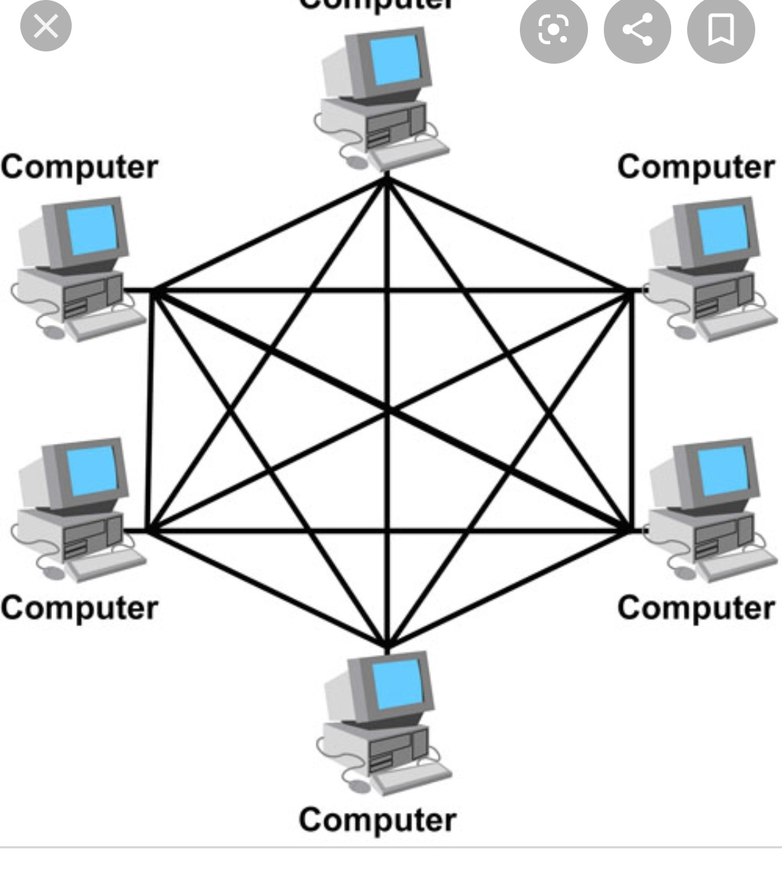

Slide 17
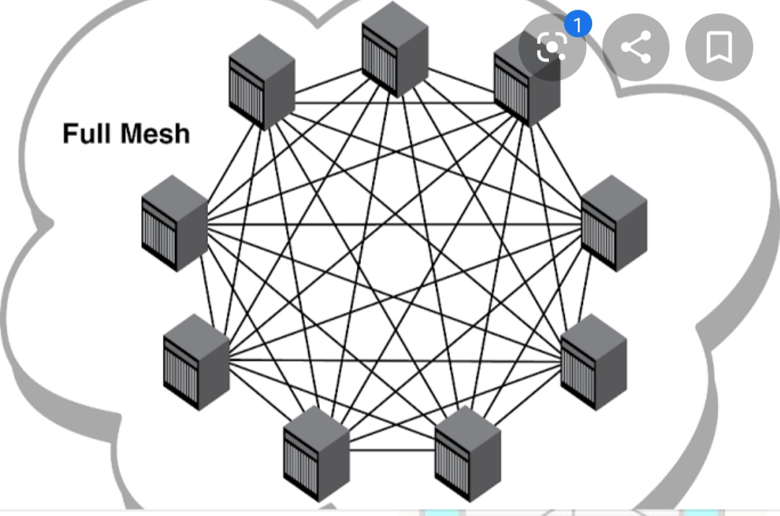

Slide 18
Hybrid topology
It is mixture of two or more topologies. These topologies a mix of bus topology, mesh topology, ring topology, star topology and tree topology.
Complex design and costly.

Slide 19
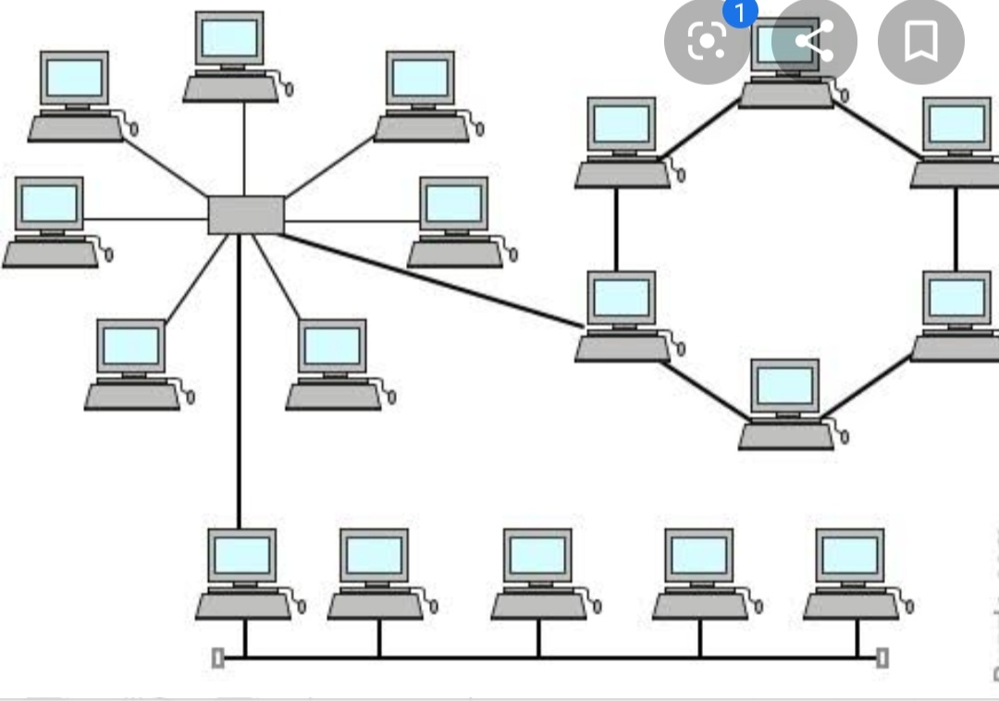

Slide 20
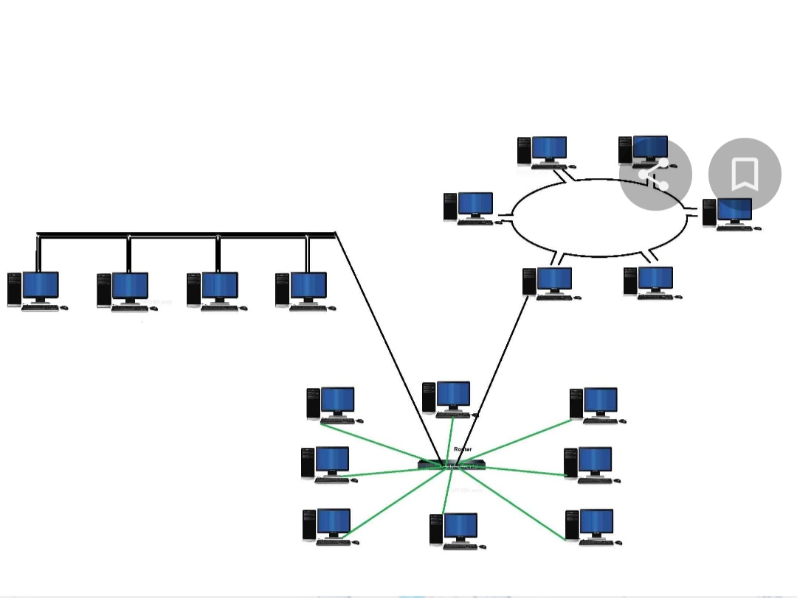

Slide 21
Thank you

